Slide 1






Combining remote-sensing and biological data to predict the consequences of climate change on hummingbird diversity
Catherine Graham, Susan Wethington, Donald Powers, Pieter Beck, Scott Goetz
Kira Newcomb, Tina Cormier, Frank La Sorte, Gil Bohrer, Ben Weinstein, Boris Tinoco, Sarah Supp, Anusha Shankar and Marisa Lim, team of Latin American interns and many many volunteers & collaborating biologists

Slide 2
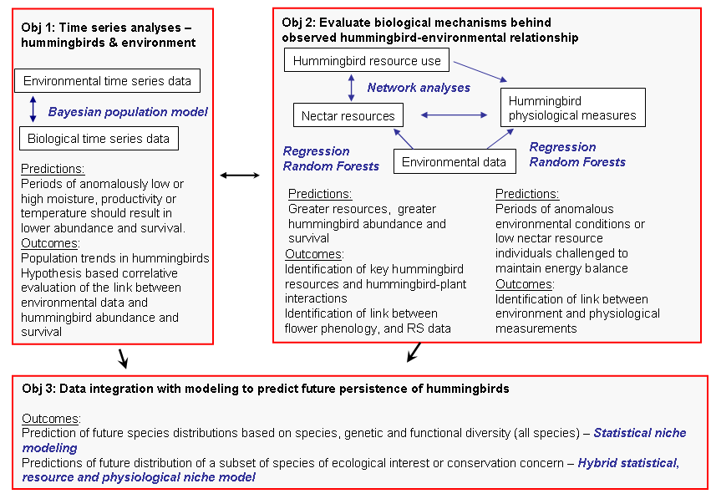
Time series hummingbird & remote-sensing
Notes:
Our three main objectives focus on
identifying patterns (objective 1) – i.e., be determining the association between hummingbird abundance, distribution and survival and environmental variables. Specifically we think that periods of anomalously low or high moisture, productivity or temperature should result in changes in abundance, distribution and survival
Evaluating some of the biological mechanisms --- we focus on what we think are the two main mechanisms – nectar resources and physiological response; Nectar is the main food source of hb so understanding what they eat and how their food is distributed has important implications for their survival and distribution, therefore we quantify nectar availability and use across regions and time. Physiological measures provide direct information on hummingbird health and their ability to maintain an energy balance in different environmental (and nectar) conditions.
Finally we will integrate these data into statistical and physiological models.

Slide 3
Survival across a broad spatial and temporal scale
Notes:
Our three main objectives focus on the influence of environmental (RS) factors on survival of hummingbirds using an extensive dataset on survival which I will tell you about in a few minutes…..
But first I will introduce study species
identifying patterns (objective 1) – i.e., be determining the association between hummingbird abundance, distribution and survival and environmental variables. Specifically we think that periods of anomalously low or high moisture, productivity or temperature should result in changes in abundance, distribution and survival
Evaluating some of the biological mechanisms --- we focus on what we think are the two main mechanisms – nectar resources and physiological response; Nectar is the main food source of hb so understanding what they eat and how their food is distributed has important implications for their survival and distribution, therefore we quantify nectar availability and use across regions and time. Physiological measures provide direct information on hummingbird health and their ability to maintain an energy balance in different environmental (and nectar) conditions.
Finally we will integrate these data into statistical and physiological models.

Slide 4
ESTIMATING SURVIVORSHIP OF
NORTH AMERICAN HUMMINGBIRDS
Using Cormack-Jolly-Seber (CJS) open population Capture-Mark-Recapture (CMR) models from banding data
Parameter estimated are:
  Survivorship (Phi)
    Actually apparent survivorship because estimate include death and emigration
  Recapture probability (p)
Restricted to annual estimates
Top candidate models chosen with AIC estimates

Slide 5


Systematic Banding Program (constant effort, robust design)
Stratified by geography and vegetation
Protocols developed for hummingbirds
Bait with feeders
Each Site sampled once every 2 weeks within a week period
Citizen Science Based
Diverse Site Partners
HMN’s
Coordinated
Monitoring
Program
Drawn by GC West
Notes:
Data are collected using the protocol of HMN’s coordinated monitoring program. For this analyses, capture histories are built from the data collected during the breeding season.

Slide 6
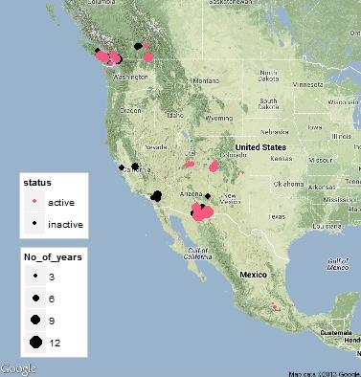
2014 Partners and Map of HMN sites
Universities:
OSU
UNAM
UA
Nonprofit Organizations:
Rocky Pt Bird Obs.
Idaho Bird Observatory
Cuenca Los Ojos
AMNH – SWRS
Government Agencies:
DOD
USFS
NPS
BLM
AZSP
This study uses 24 sites
Notes:
Sites used in this analyses are in Arizona, Colorado, Utah, and Idaho. Monitoring data used from 2002-2014 but the number of years and the start year among the sites.

Slide 7
Factors affecting parameter estimates of CJS Candidate Models
Recapture Probabilities
  Predicted factors: nearby feeders, relative abundance of hummingbirds at each site
  Site is the top factor (includes above factors)
Survivorship
  Predicted factors: species, sex, migration strategy, geographic factors (latitude, longitude, elevation), environmental factors
  Multi-species model runs
  Single-species model runs
Notes:
Multi-species runs to test effect of migration strategy, general sex patterns, and geographic factors.
Single species runs investigate individual species patterns. Additionally, models are unable to make valid estimates with in species in the multi-species runs

Slide 8
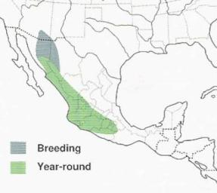
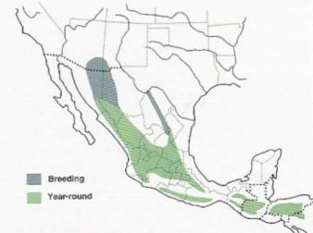
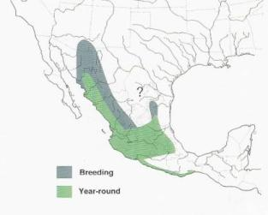
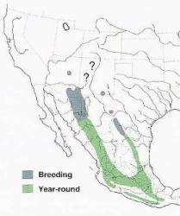
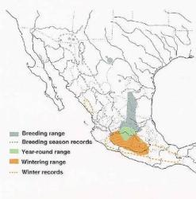
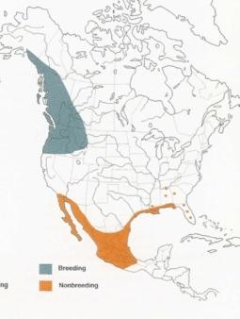
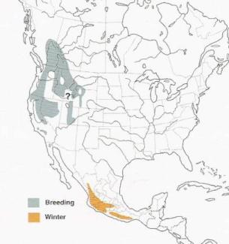
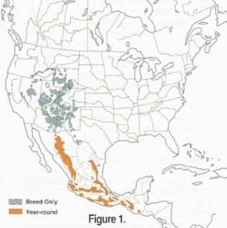
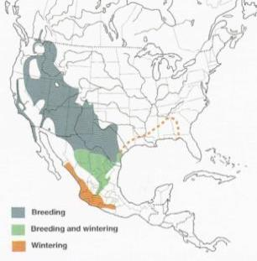
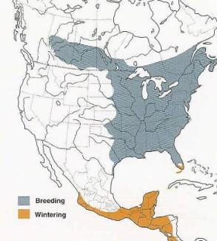
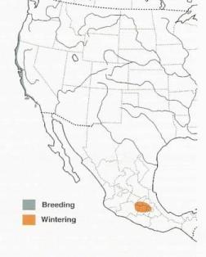
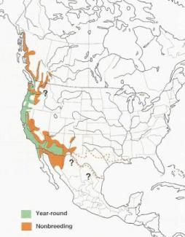
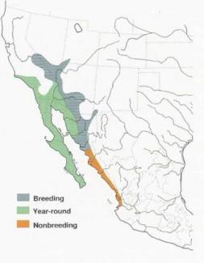
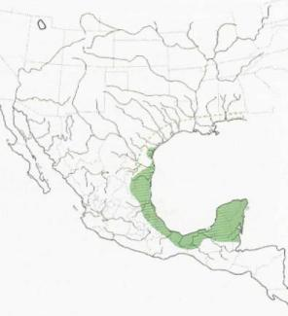
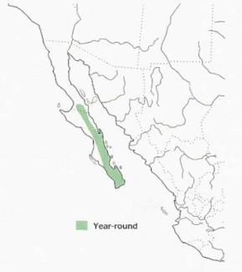
Violet-crowned Magnificent Broad-billed Blue-throated Lucife
Rufous Calliope Broad-tailed Black-chinned Ruby-throated
Allens Anna’s Costa’s Buff-bellied Xantus
Notes:
Two migration strategies: Latitudinal Migrants & Range Expansion Migrants. Range maps demonstrate the differences between species.

Slide 9
Violet-crowned Magnificent Broad-billed Blue-throated Lucife
Rufous Calliope Broad-tailed Black-chinned Ruby-throated
Allens Anna’s Costa’s Buff-bellied Xantus
Notes:
Species included in the analyses are: Latitudinal Migrants (in red) are Black-chinned (BCHU), Broad-tailed (BTLH), and Calliope (CAHU)
Range Expansion migrants (in green) are: Broad-billed (BBLH), Magnificent (MAHU), and BLUH (Blue-throated)

Slide 10
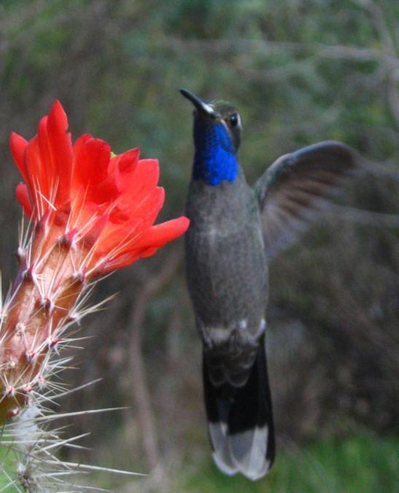
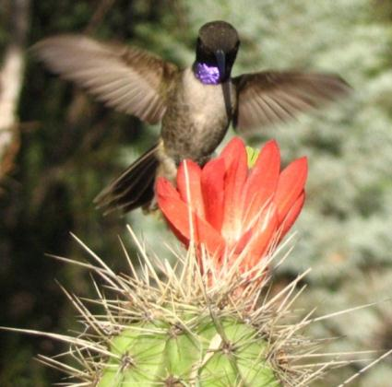
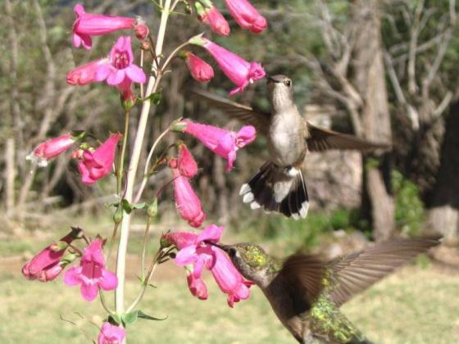
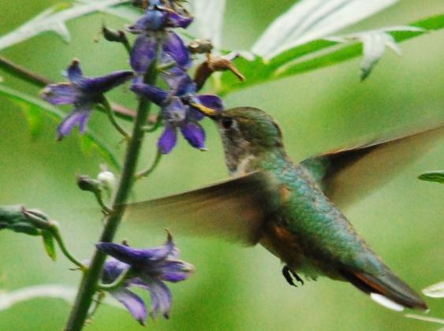
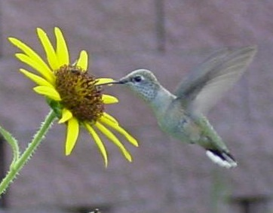
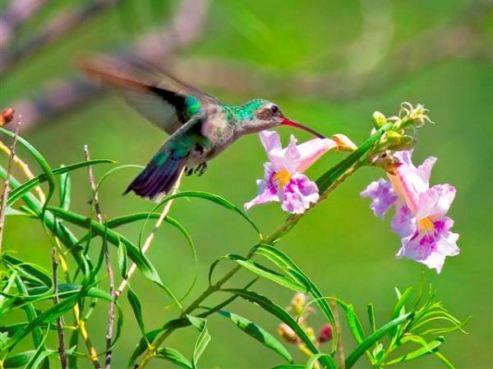
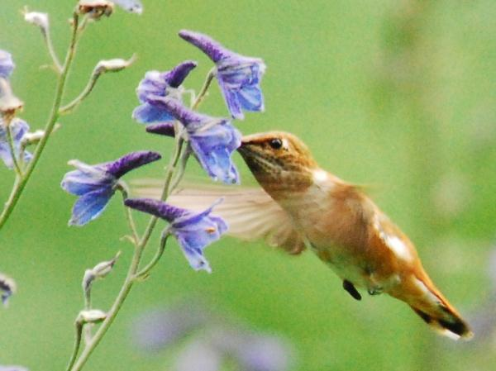
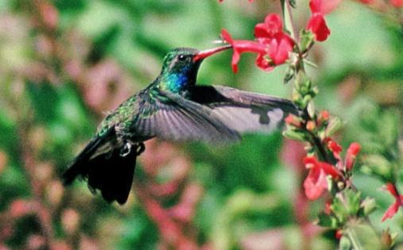
Notes:
Data from six species (Black-chinned, Broad-tailed, Calliope, Broad-billed, Magnificent, and Blue-throated) are included in the analyses.

Slide 11
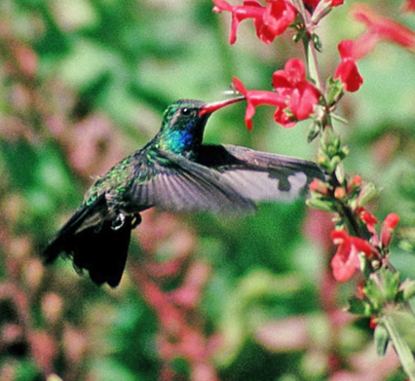
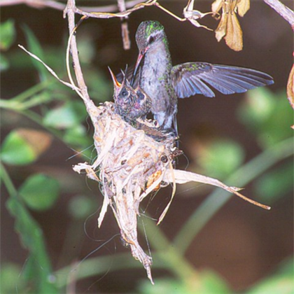

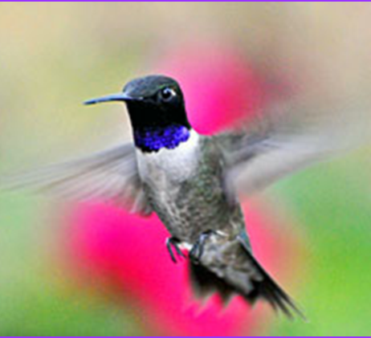
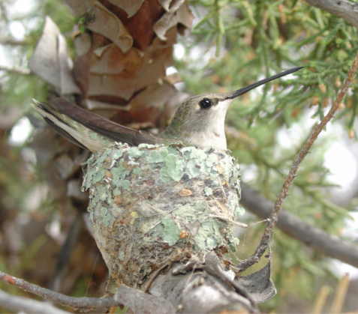

Focal Species: Broad-Billed (Cynanthus latirostris)
Black-chinned (Archilochus alexandri)
Notes:
Male and female survivorship estimates of birds often differ. One suggested reason for this difference is that males return first to the breeding grounds and thus likely encounter more adverse environmental conditions than the later arriving females. Additionally, survivorship may vary between sexes of hummingbirds is that females perform all nesting/fledging activities. Thus, conditions on the breeding grounds likely influence female survivorship more than males. Males can simply leave under adverse conditions.
Migratory strategy likely impacts survivorship rates. In many studies that link survivorship of migrant birds to life stages such as breeding, over-wintering, and migration, the result is often that migration often has the largest adverse impact on survivorship. Thus, latitudinal migrants which cover longer distances and thus spend more time migrating will likely experience more impact on survivorship.
In contrast range expansion migrants’ survivorship are likely affected more by the quality of preferred habitat which is likely limited at the edge of range boundaries (they are expanding range limits) . With these contrasting challenges between the sexes and different migrant strategies, we predict that survivorship will be higher for range expansion migrants in years of good environmental conditions and that survivorship of males will be lower for those populations experiencing greater environmental conditions.

Slide 12
Predictions
Females will have lower survival than males
With the exception of long distance migrant males will have lower survival than females or short distance migrants
Environmental factors associated with resources and temperature should influence survival

Slide 13
Evaluating how environmental data affects hummingbird survivorship
To model physiological demand, temperature is used; so we include
  Mean Tmin, Mean Tmax, land surface temperature in the list of candidate models
To model resource availability (floral nectar resources and insects), we include
  NDVI, precipitation, and aridity in the list of candidate model

Slide 14
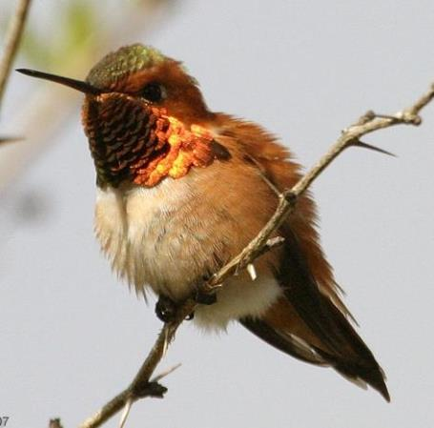

RUFOUS HUMMINGBIRD PIF Species of Continental Concern
Precipitation and winter temperature predict long-term range-scale abundance changes in Western North American birds. Gutiérrez et. al 2014
Notes:
Why did we choose specific variables.. Move down

Slide 15
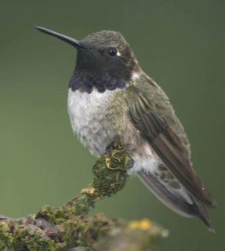
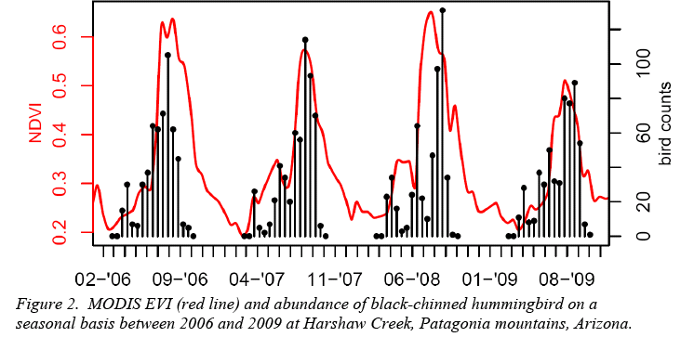
Time series analyses – hummingbirds and environment
Seasonal hummingbird abundance patterns correspond to vegetation activity
Notes:
Preliminary analyses suggest a strong correspondence between environmental factors (EVI) and abundance patterns of the black-chinned hummingbird

Slide 16
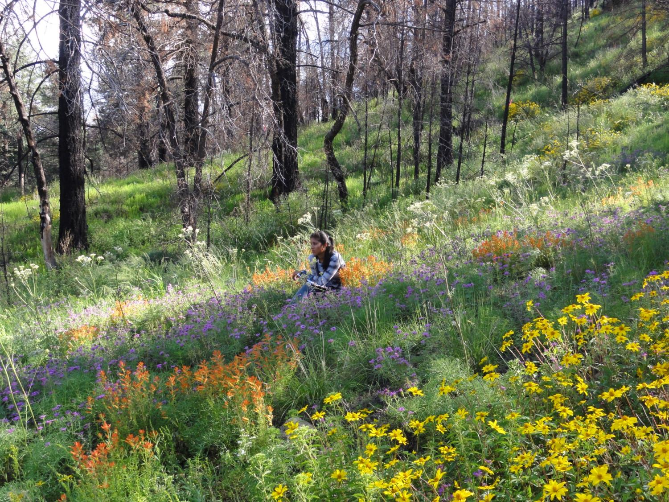
Notes:
As Pollinators, hummingbirds have a close association with their nectar plants and environmental variables affecting their flowering plants will likely influence their survivorship. For some plants, it has been documented that increased rain increases nectar production.

Slide 17
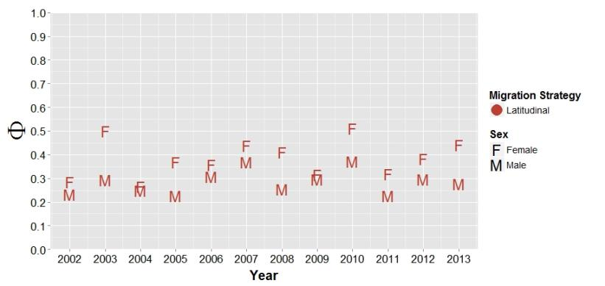
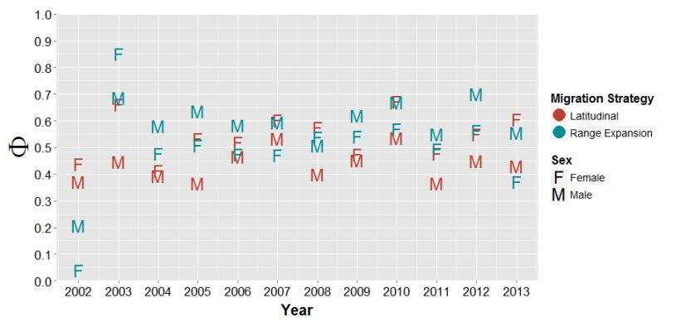
Multi Species Model Results with out Environmental factors
TOP MODELS | Number of PARAMETER | DELTA AICc
Phi(~MigrationStrategy * Sex * time + Lon_Group)p(~Location) | 71 | 0.00
Phi(~MigrationStrategy * Sex + time * Lon_Group)p(~Location) | 60 | 6.78
Longitude -116 Longitude -109
Notes:
Different survivorship patterns between sexes of latitudinal and range expansion migrants; longitudinal classes show weak trend of higher survivorship in east than west. (Need to investigate the significance of this pattern). Phi = Survivorship, p=recapture probability

Slide 18
Multi Species Model Results with Environmental factors
TOP MODELS | Number of PARAMETER | DELTA AICc
Phi(~MigrationStrategy * w.ndvi_3km * time)p(~Location) | 69 | 0.00
Phi(~MigrationStrategy * b.tmax_3km * time)p(~Location) | 69 | 14.46
Notes:
Due to the lack of power, migration strategy and sex factors are in different model runs.
Migration Strategy in top models. Sex is small in comparison.
Should have eliminated year in these models.

Slide 19
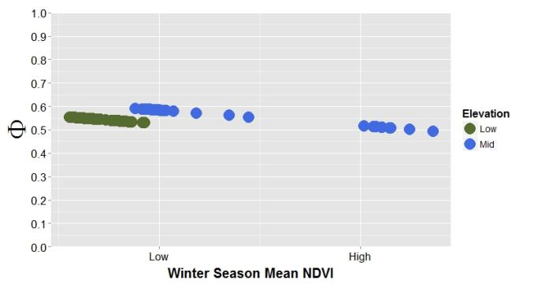
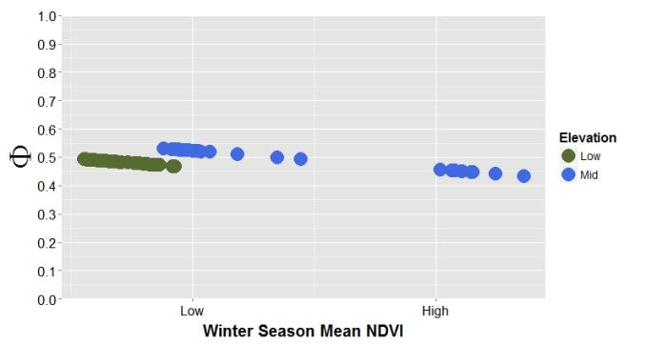
Factors influencing Broad-billed (range expansion migrant) survivorship
Males
Females
Sex, wintering NDVI, and elevation factors in top models
TOP MODELS | Number of PARAMETER | DELTA AICc
Phi(~Sex + w.ndvi_3km + Elev_Group)p(~Location) | 11 | 0.00
Phi(~Sex * w.ndvi_3km + Elev_Group)p(~Location) | 12 | 1.65
Notes:
Males have higher survivorship. Individuals at mid-elevations have higher survivorship BBLH occur at only low and mid elevations
All sites with BBLH are in Arizona. The decline in survivorship with increasing winter mean NDVI is likely due to the weather patterns in Arizona over the last decade. When there is good winter rains, the following summer rains are less.

Slide 20
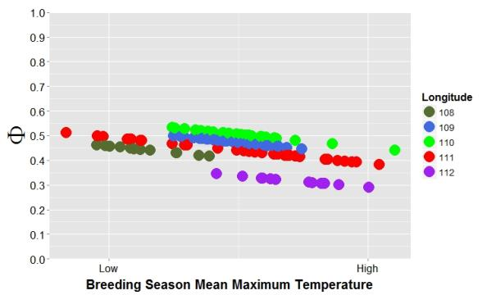
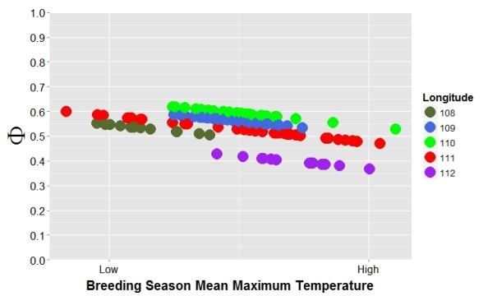
Factors influencing Black-chinned (latitudinal migrant) survivorship
MALE
FEMALE
Sex, breeding mean Tmax and longitude factors in top models
TOP MODELS | Number of PARAMETER | DELTA AICc
Phi(~Sex + b.tmax_3km + Lon_Group)p(~Location) | 17 | 0.00
Phi(~Sex * b.tmax_3km + Lon_Group)p(~Location) | 18 | 1.95
Notes:
Females have higher survival rates
In general, populations in the western longitude class have lowest survival rate
With increasing mean Tmax in breeding season, lower survivorship.

Slide 21
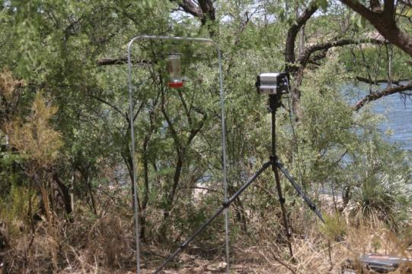
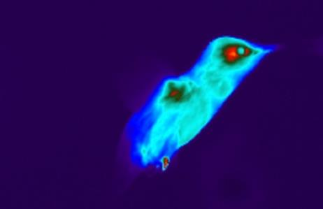
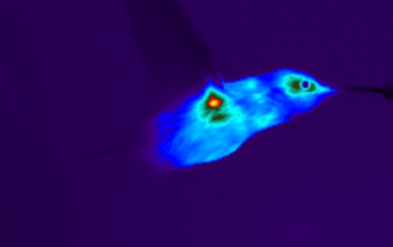
Physiological Response
Daytime Temperature Effects
Environmental Temperature (T_{a}/T_{e})
Thermal Load
(IR Imaging)
DEE/FMR (DLW)
Hovering
Forward Flight

Slide 22
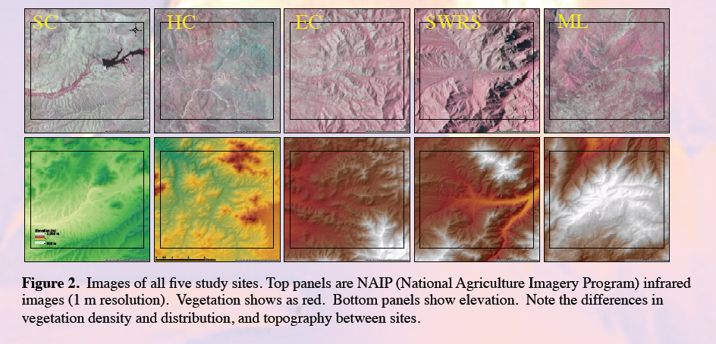
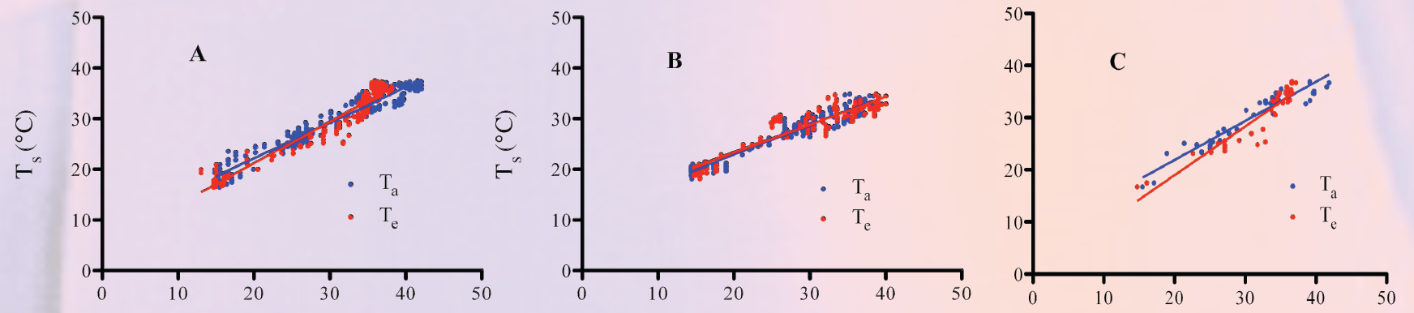

Slide 23
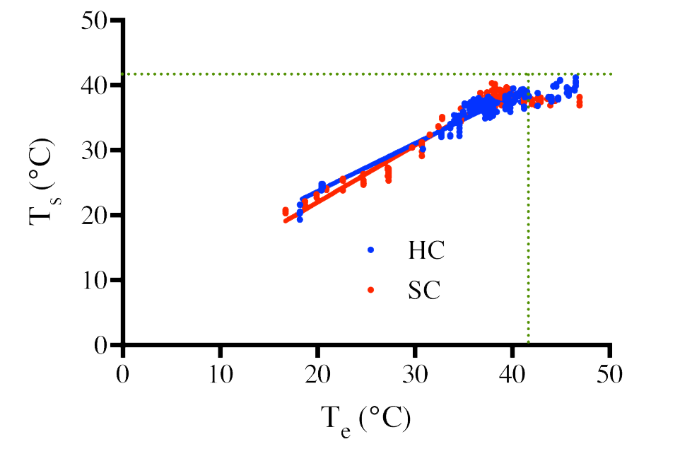
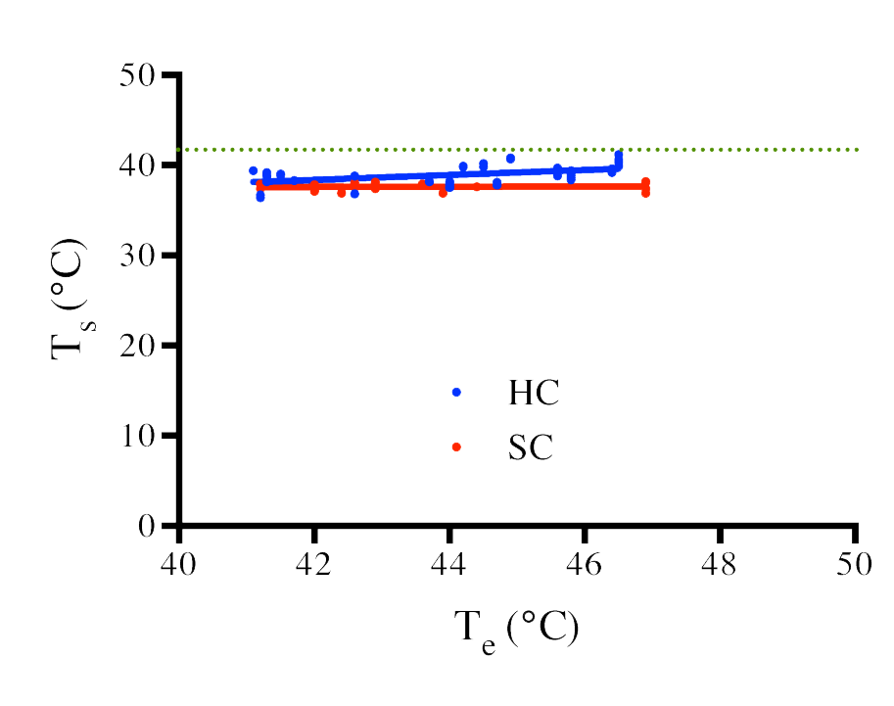
Assumed T_{b}
Surface temperature (T_{s}) increases linearly with T_{e} until T_{e} = 41°C.
When T_{e} > 41°C T_{s} is stable above 40°C.
T_{s} regulation above 40°C – could increase Daily Energy Expenditure.

Slide 24
Conclusions
Survival varies by hummingbird sex and migration strategy
Environmental variables appear to influence survival
In particular, maximum temperature influences survival of range expansion migrants
Physiological and landscape data are consistent with the importance of temperature
Results are still preliminary but exciting!

Slide 25
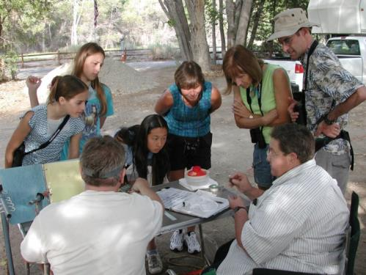

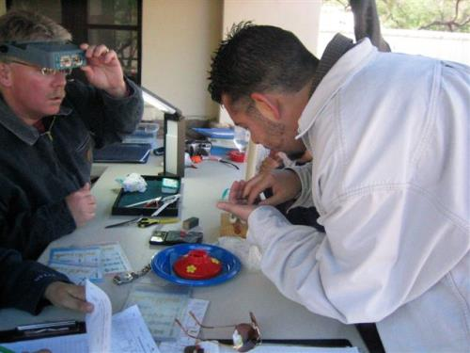
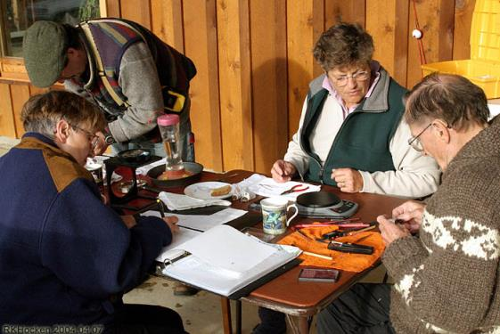
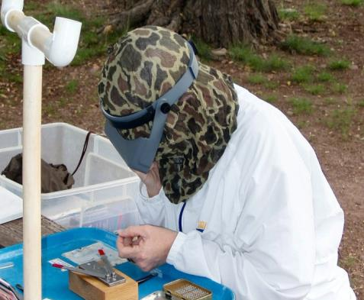



THANKS to HMN Citizen Scientists and volunteers
Notes:
Slide 30- One more thank you and importance of community volunteers

Slide 26

Questions?
Anything bugging you?

Slide 27

Estimating Hummingbird Population Sizes

Slide 28


Slide 29



Slide 30

CP 9

Slide 31


